Slide 1

B.Tech (IT) Minor Project Presentation 2022 Expense Tracker System
Piyush Katyayan (19BTechIT05)
Seli Sinha (19BTechIT59)
Manash Protim Deori (19BTechIT50)
Kaushik Saikia (19BTechIT29)
Under the supervision of
Dr. Khwairakpam Amitabh
Department of Information Technology
North-Eastern Hill University
Shillong

Slide 2
Outline
Objective
Introduction
Background
Motivation
Proposed Method
Software Architecture
ER Diagram
Data Flow Diagram
Results
Conclusion
Future Proposed
References

Slide 3
Objective
To develop android application for expense tracking and financial management of the user.

Slide 4
Introduction
Every earning people are mostly confused at the end of the month as they cannot remember where all of their money have gone, where they have spent and ultimately have to sustain in little money minimizing their essential needs.
There is no as such complete solution present easily or we should say free of cost which enables a person to keep track of its daily expenditure easily and notify them if they are making high expenditures.

Slide 5
Background
Expense tracker is a refined system which allows user to efficiently manage his/her expenses with ease. Tracking expenses daily can really help us save lot of money.
Once we start off by tracking our expenses each day, we will be able to get a better idea where you are spending your money, so you stay in control and achieve your goal. It will be a reminder to save money for the expenses.

Slide 6
Motivation
As a student who has to depend on his guardians for pocket-money, I can say money management is hard. We need something to track our expenditure process, but it’s a “24 x 7” job.
As we need something that sticks with us and we can look up to daily, nothing comes to our mind other than having an application right on our phone.

Slide 7
Proposed Method
As part of personal financial journal, users enter the amount and the item they are spending money on, the software automatically adjusts the balance as necessary.
The app can provide whole history of transactions by monitoring and managing the expenditures that includes basic needs (i.e. grocery items, medical bills etc.) and other extra items.

Slide 8
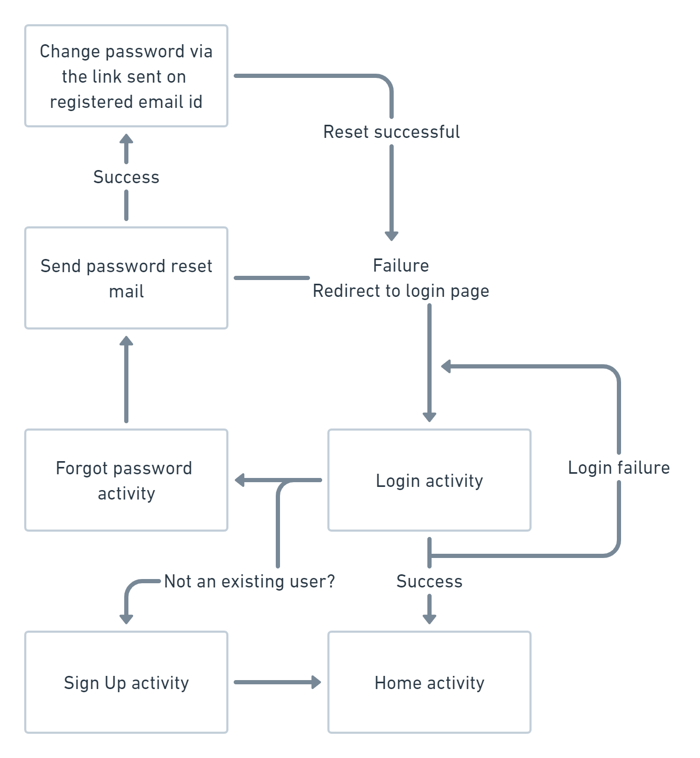
Software Architecture
.

Slide 9
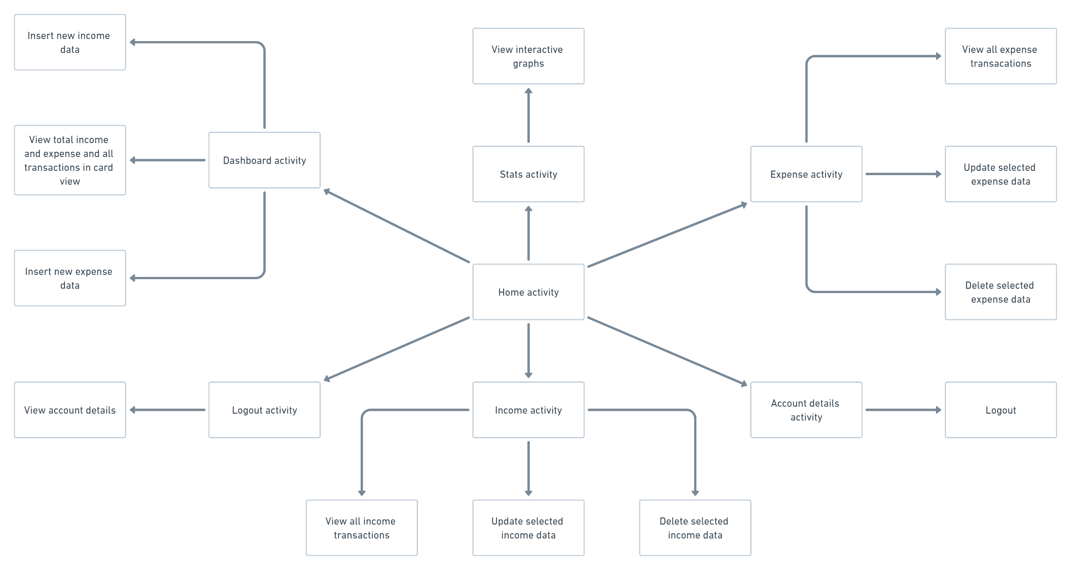
Software Architecture (cont.)
.

Slide 10
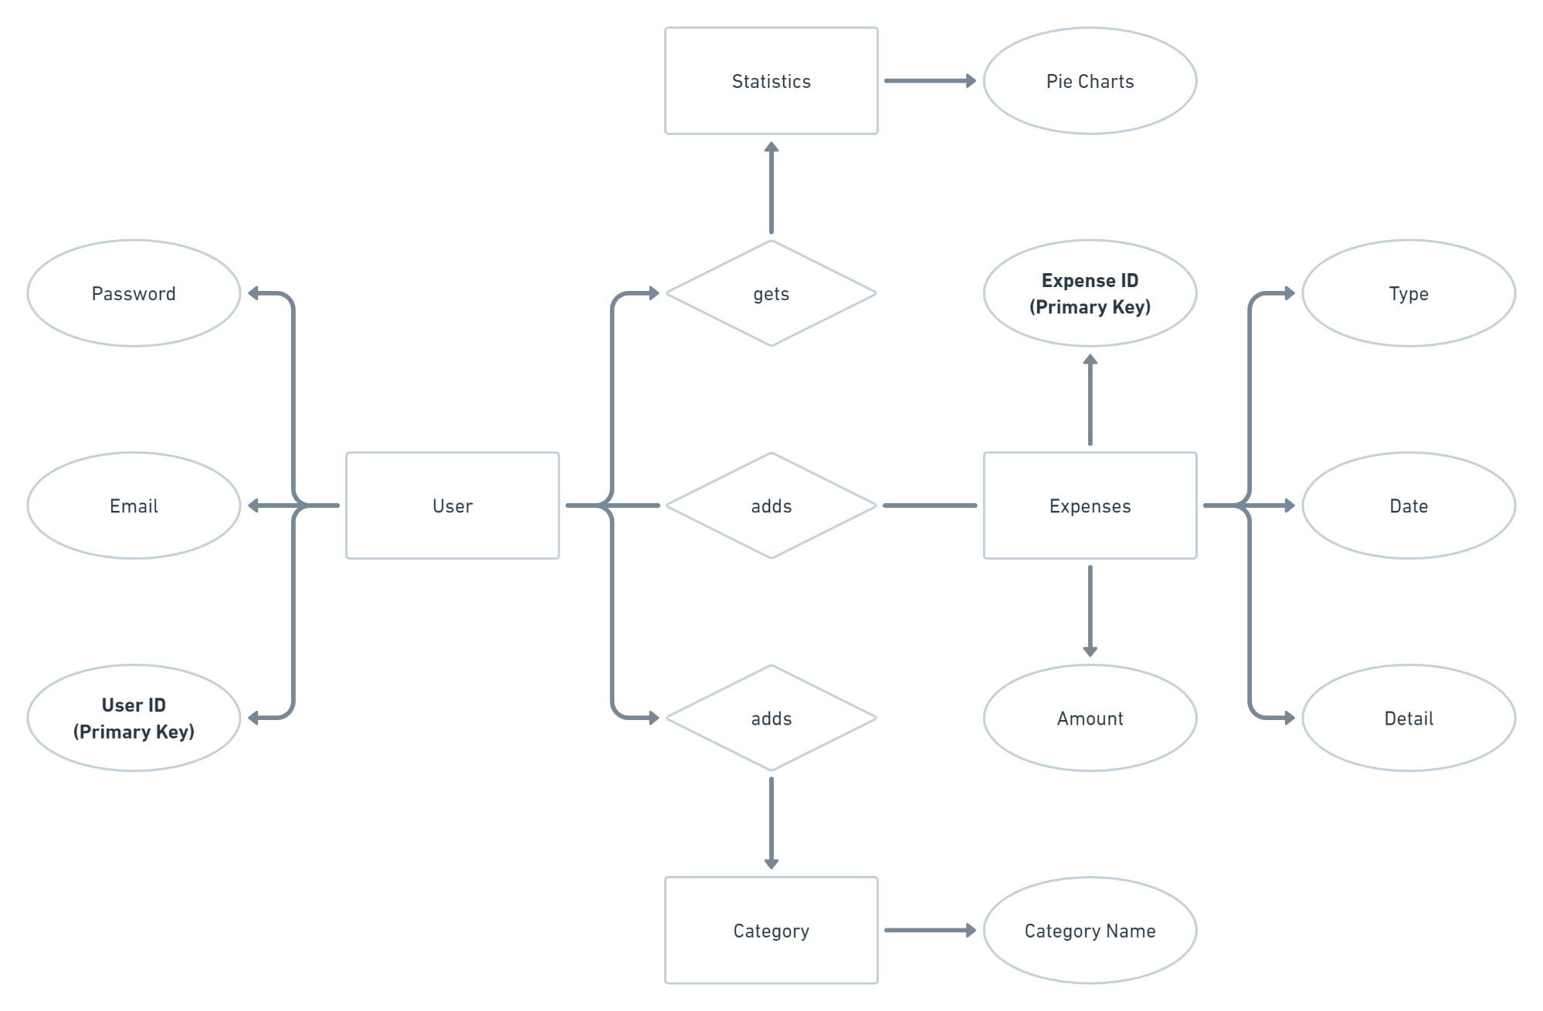
ER Diagram
.

Slide 11
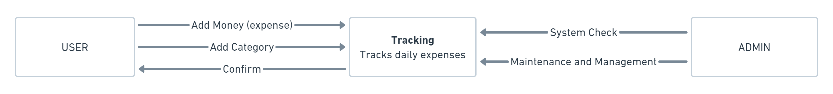
Data Flow Diagram
Level - 0

Slide 12
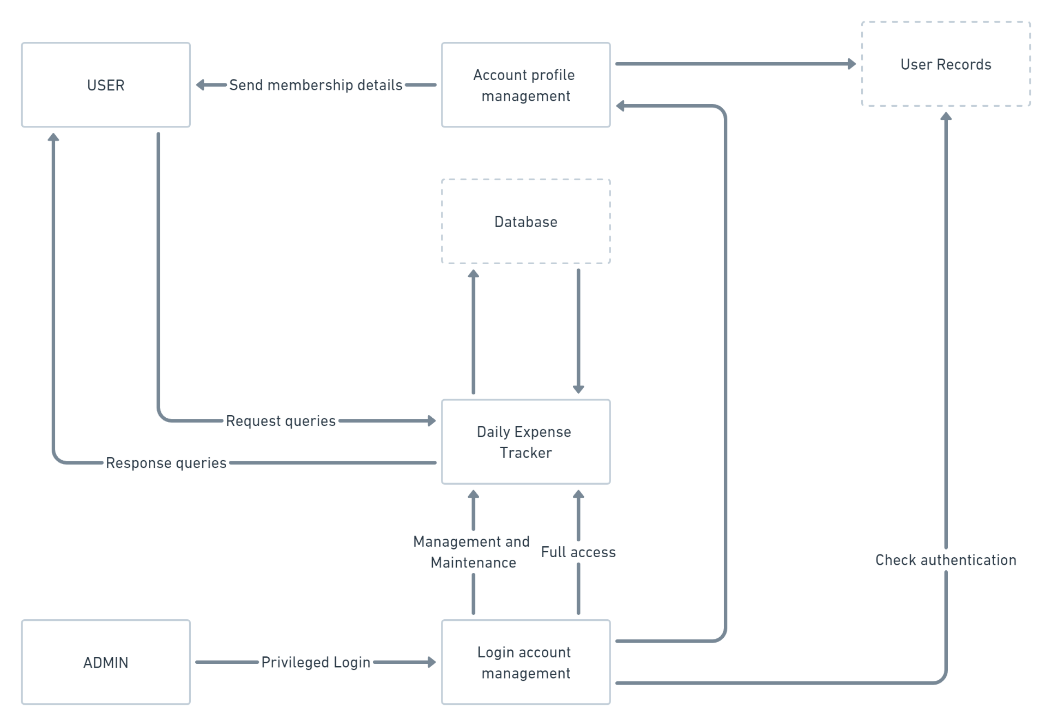
Data Flow Diagram (cont.)
Level - 1

Slide 13
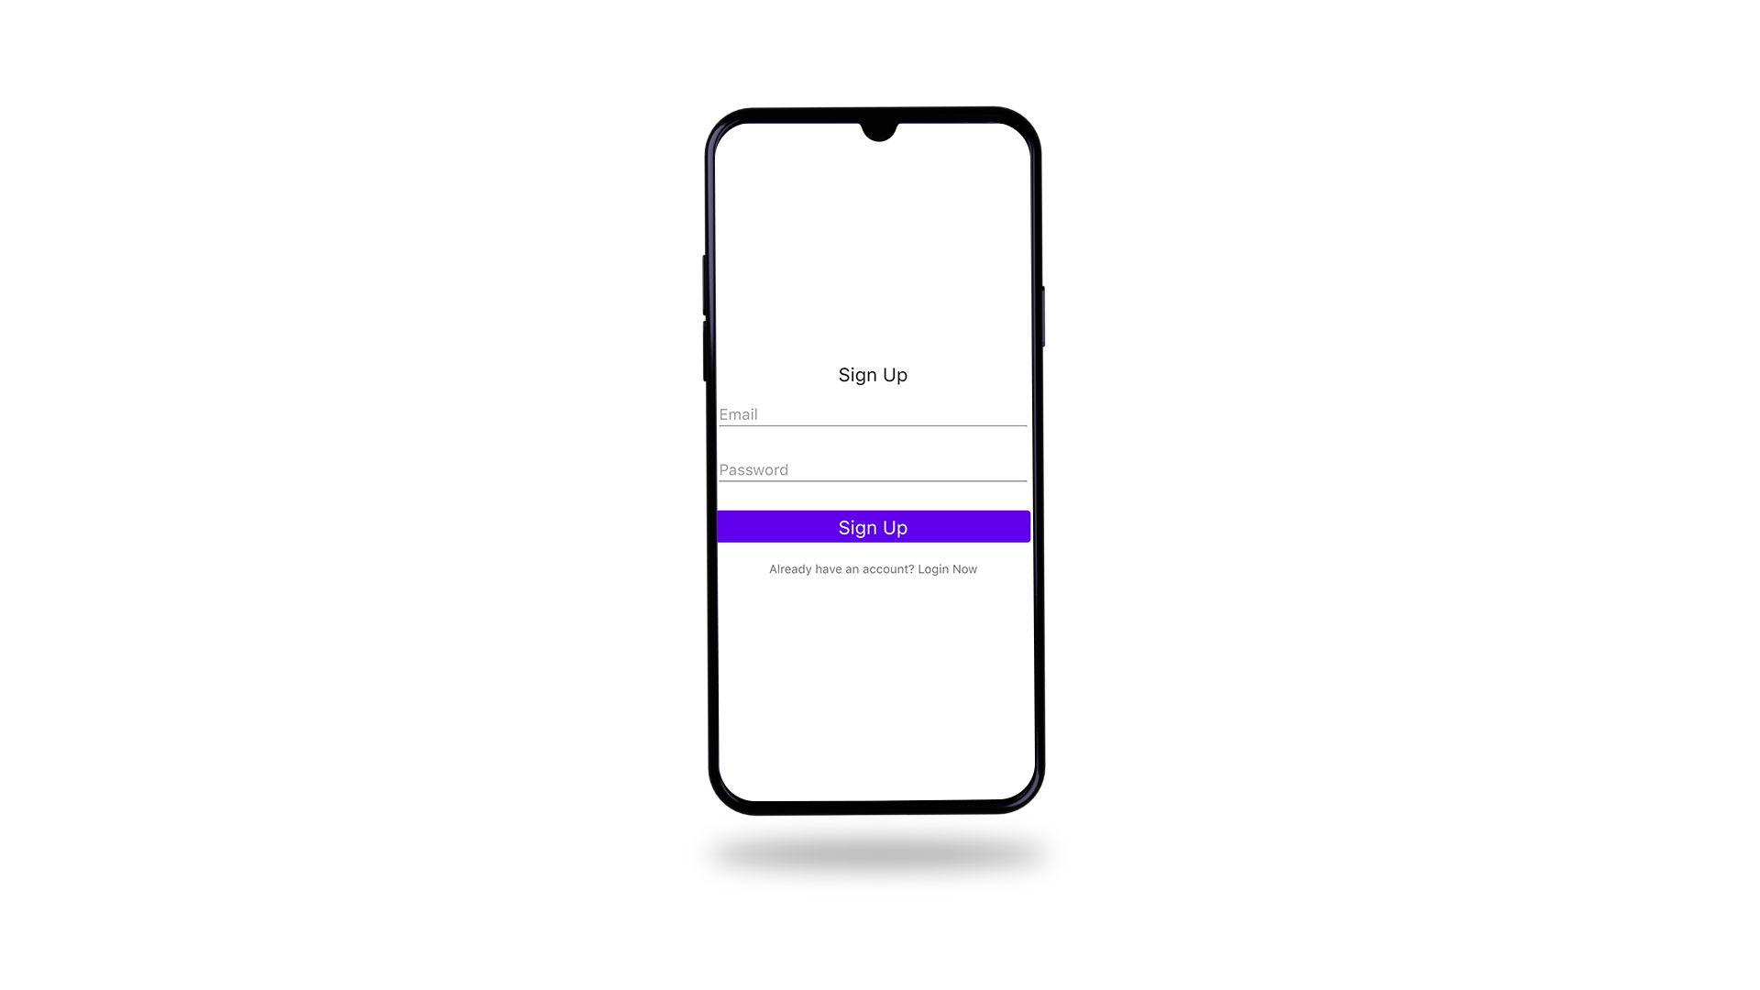
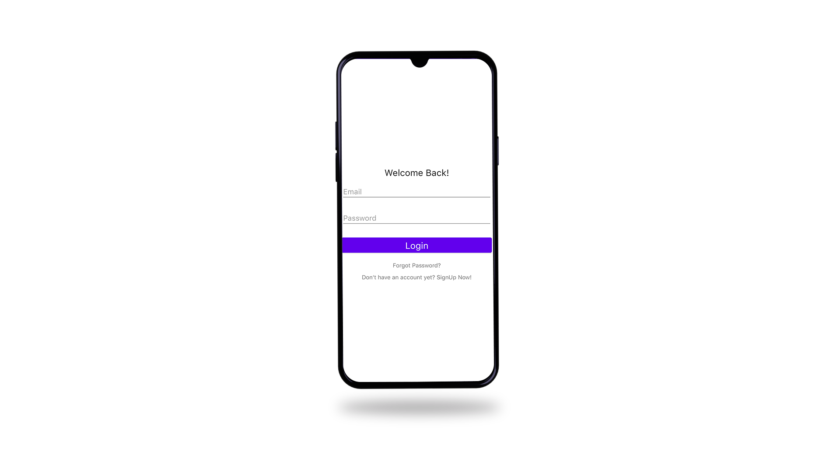
Results
Signing Up

Slide 14
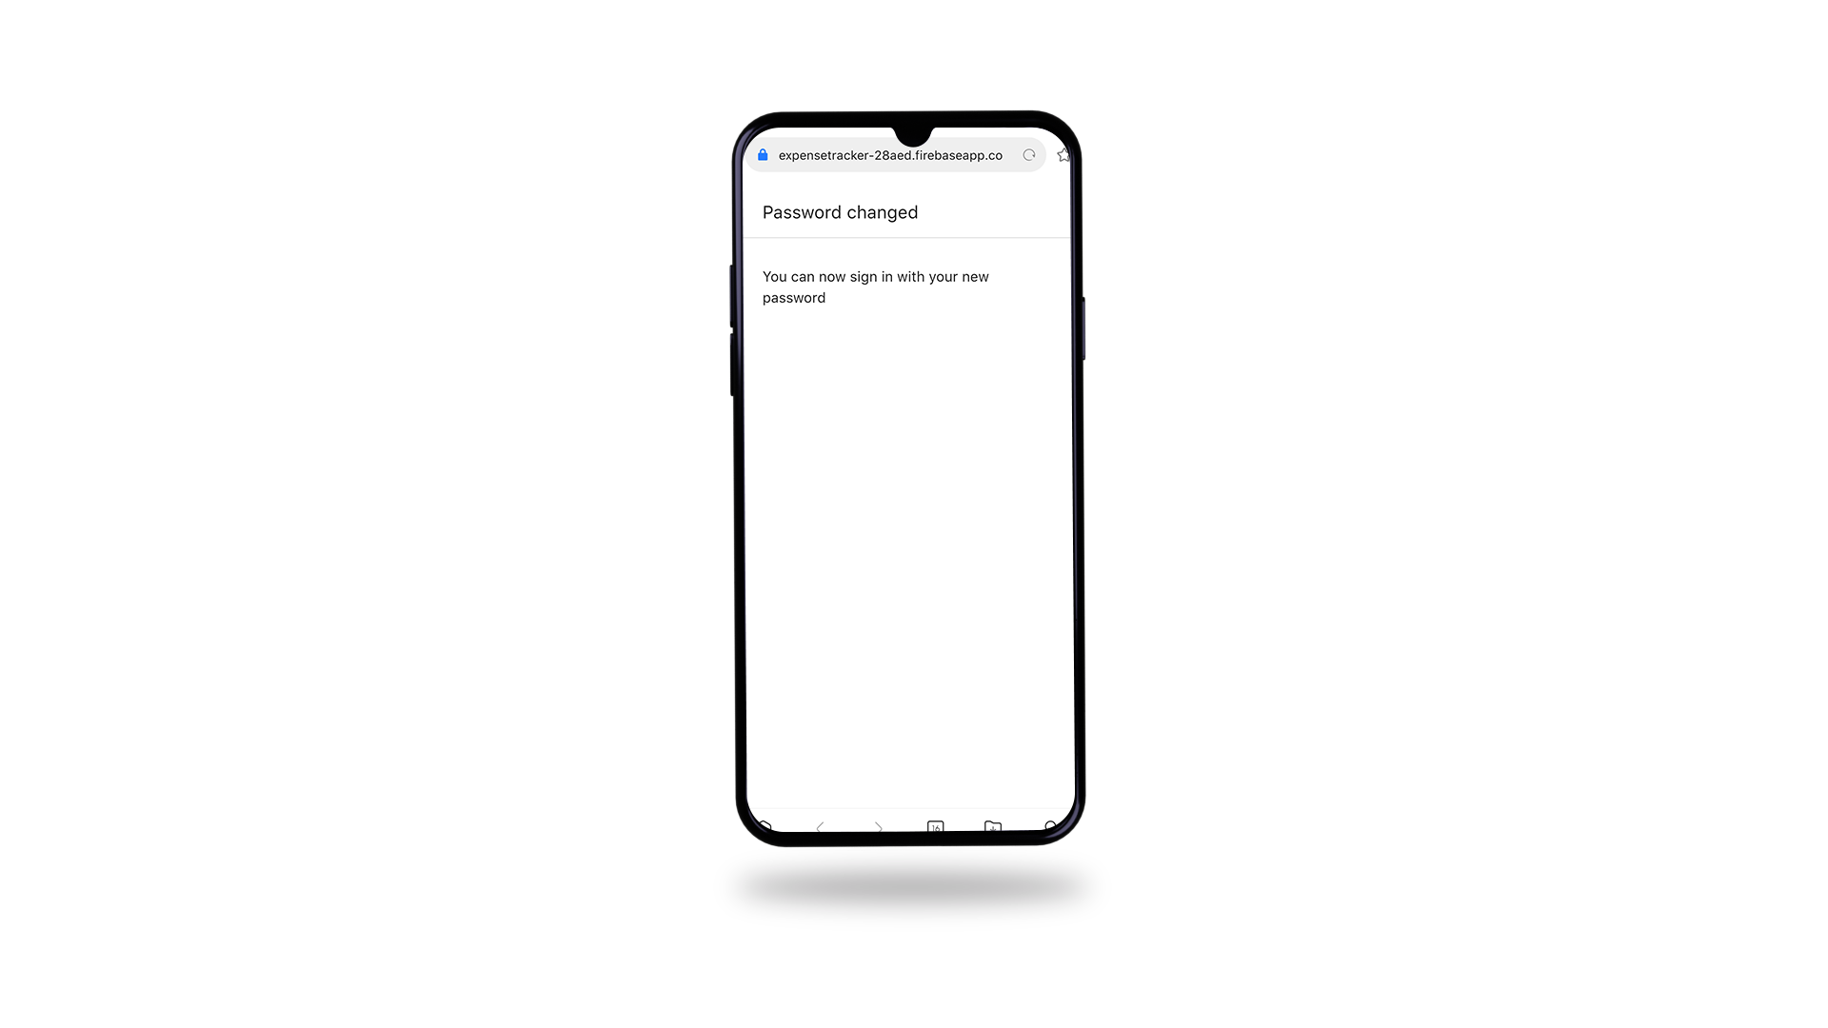
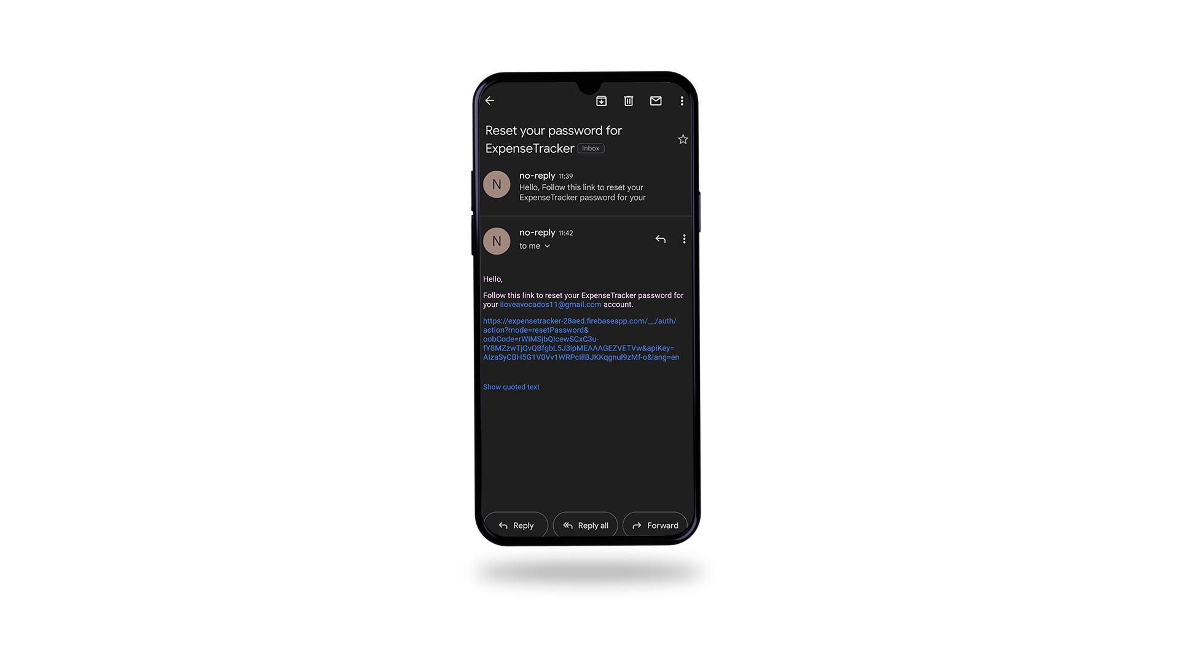
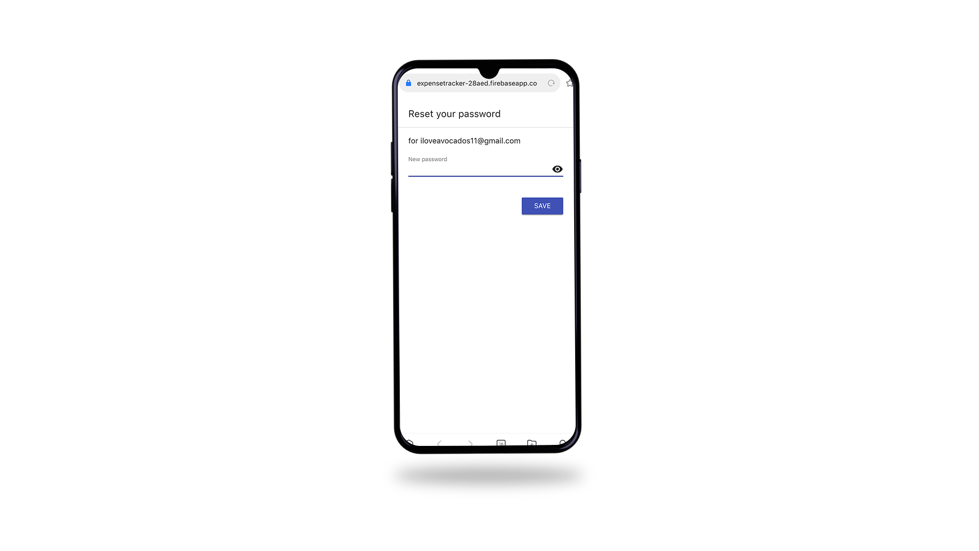
Results (cont.)
Reset Password

Slide 15
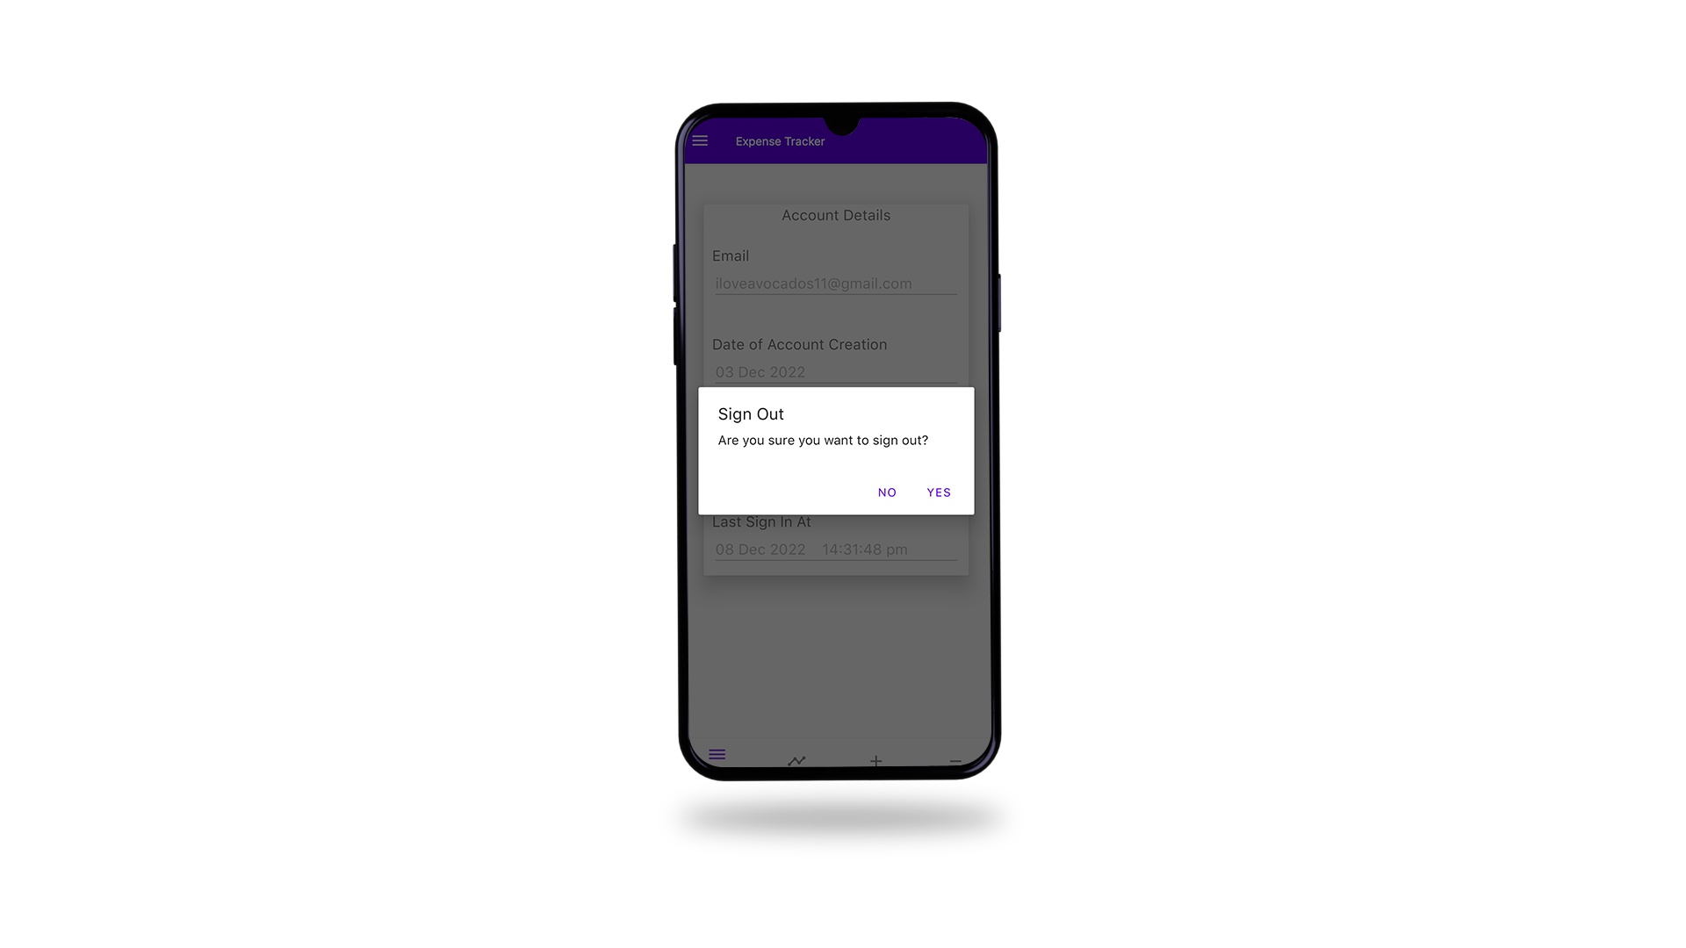
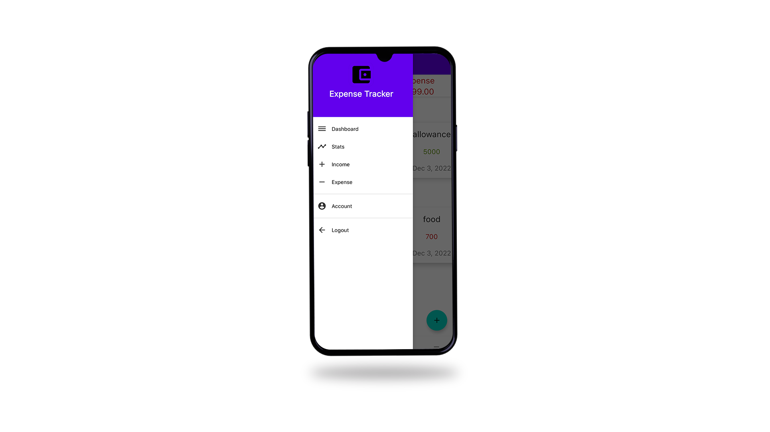
Results (cont.)
Signing Out
Navigation Bar

Slide 16
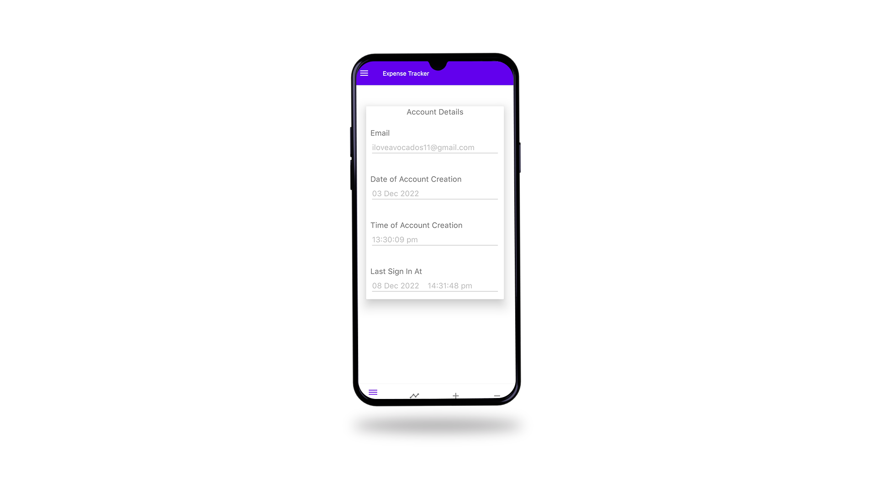
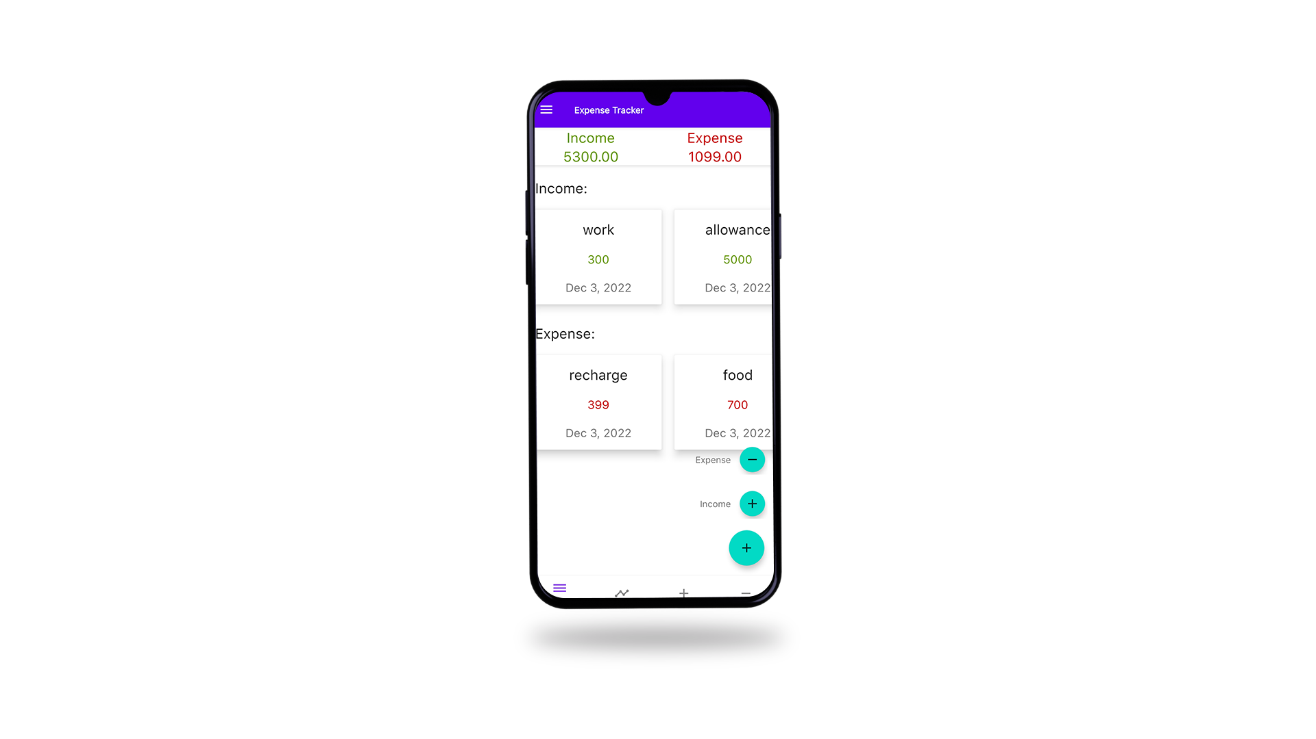
Results (cont.)
Account details
Dashboard

Slide 17
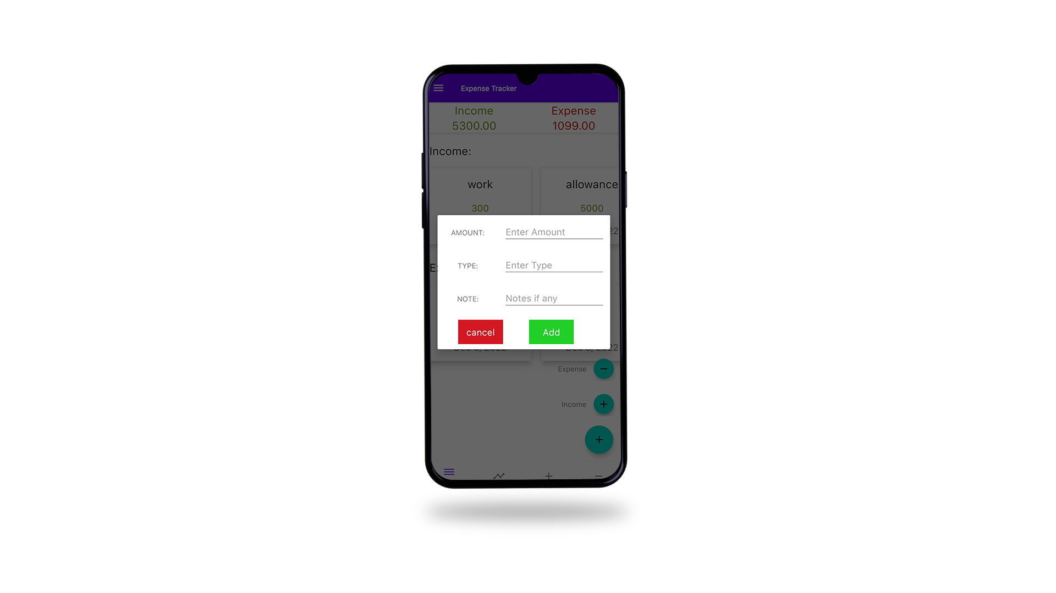
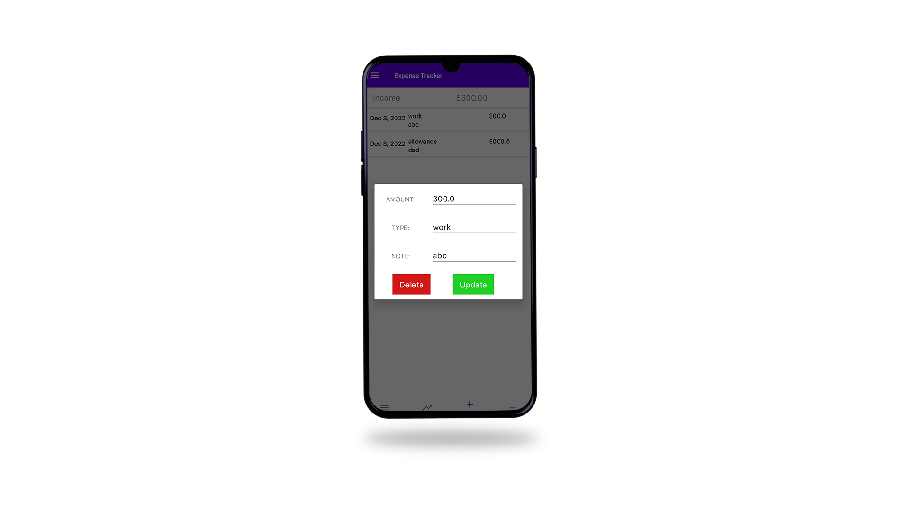
Results (cont.)
Adding
Updating

Slide 18
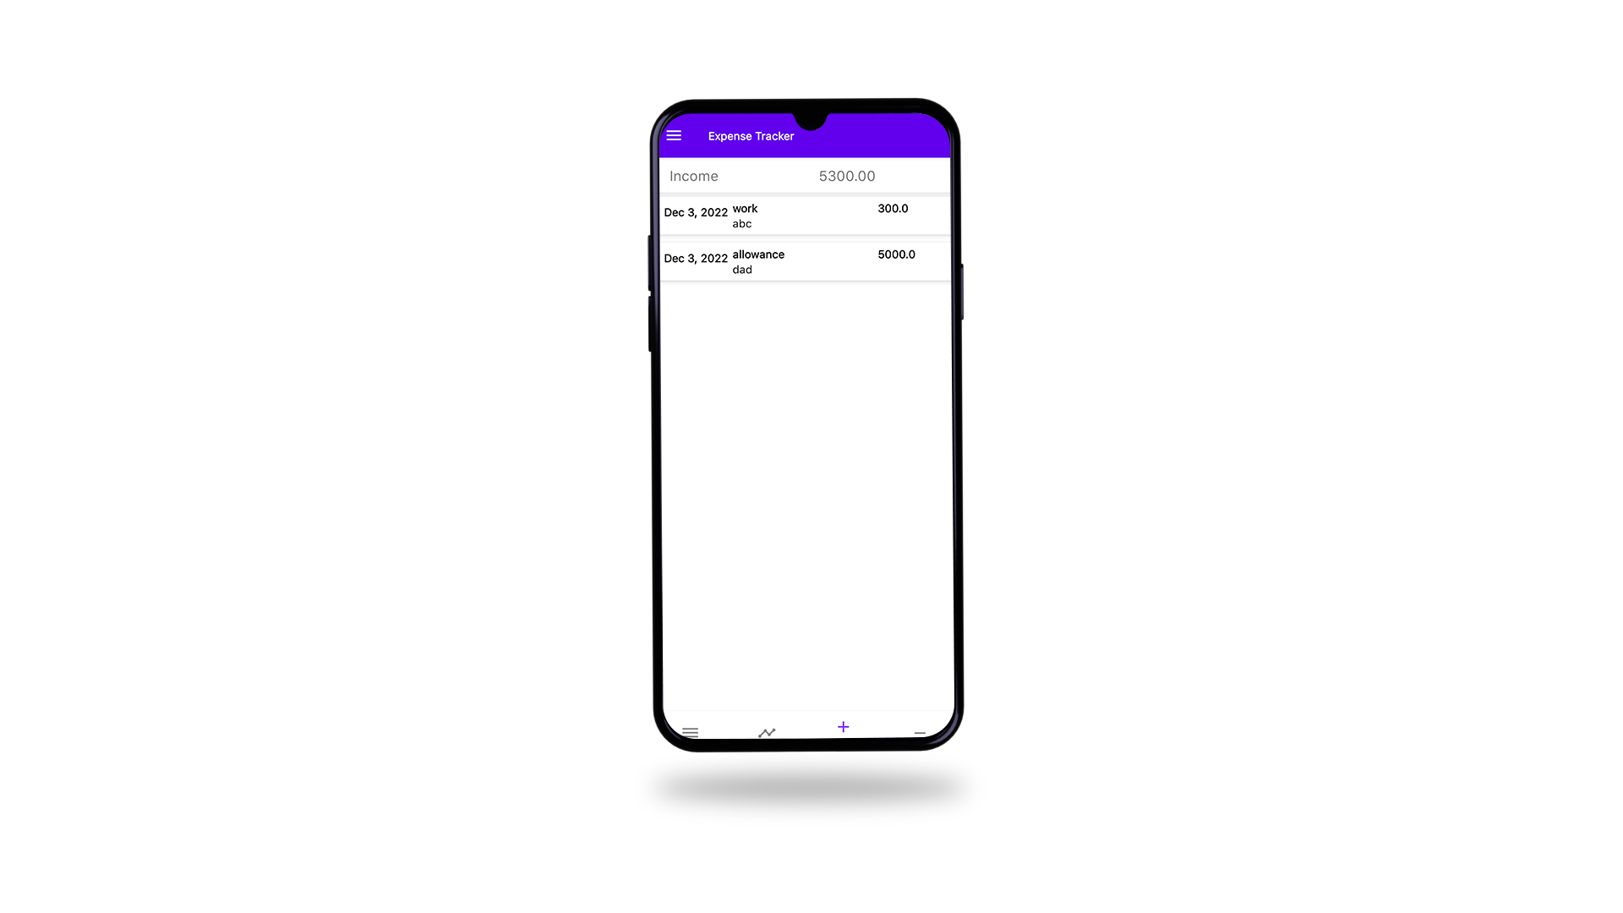

Results (cont.)
Income report
Expenditure report

Slide 19
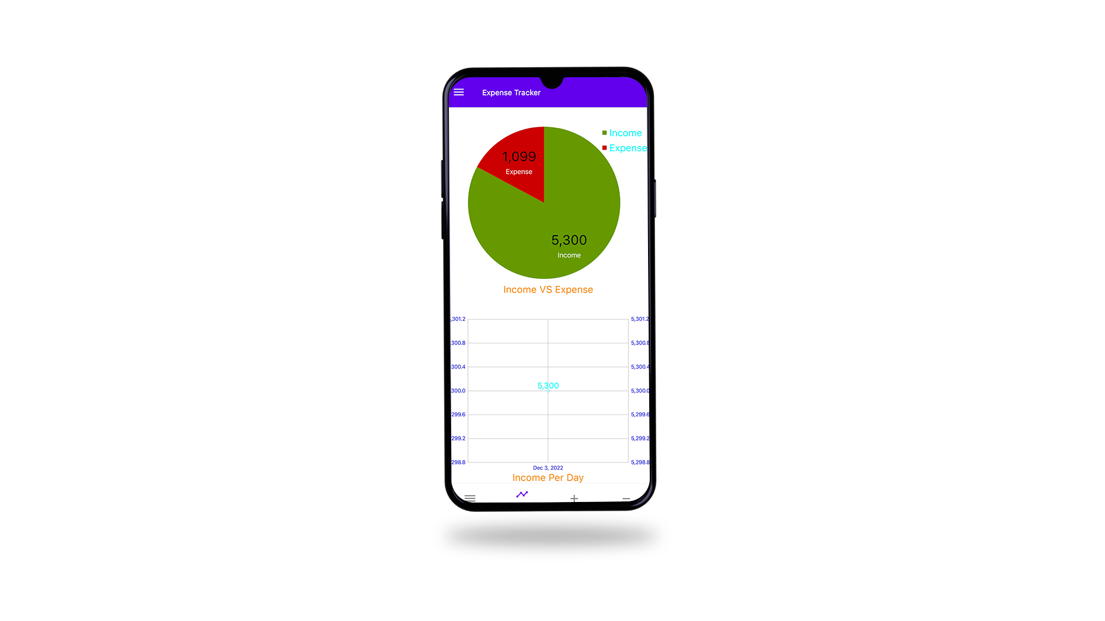
Results (cont.)
Pie chart analysis

Slide 20
Conclusion
After development of this application we assure that it will help its users to manage the cost of their daily expenditure.
It will guide them and aware them about their daily expenses.
It will prove to be helpful for the people who are frustrated with their daily budget management, irritated because of amount of expenses.
If someone wishes to manage money and to preserve the record of their daily cost which may be useful to change their way of spending money.
In short, this application will help its users to overcome the wastage of money.

Slide 21
Future Proposed
Create a statistics activity that will display a graph of the income and expense curve.
Upgrade the app's user interface design.
Generate the alert feature if expense is increasing.
User details will be backed up on cloud.

Slide 22
References
Introduction to Android: https://google-developer-training.github.io/android-developer-fundamentals-course-concepts-v2/unit-1-get-started/lesson-1-build-your-first-app/1-0-c-introduction-to-android/1-0-c-introduction-to-android.html
Android for developers: https://developer.android.com/
Android software development: https://en.m.wikipedia.org/wiki/Android_software_development
En.wikipedia.org (2018): https://en.wikipedia.org/wiki/Systems design [Accessed 2 May. 2018]

Slide 23
Thank
You

